Slide 1
Making Solomon
February 2, 2017 – Black Code studies

Slide 2
What is code?
In computing, source code is any collection of computer instructions, possibly with comments, written using a human-readable programming language, usually as ordinary text.
Paul Ford: “Computers are machines. They don’t know what a screen or an “a” are. To put the “a” on the screen, your computer has to pull the image of the “a” out of its memory as part of a font, an “a” made up of lines and circles. It has to take these lines and circles and render them in a little box of pixels in the part of its memory that manages the screen.”

Slide 3
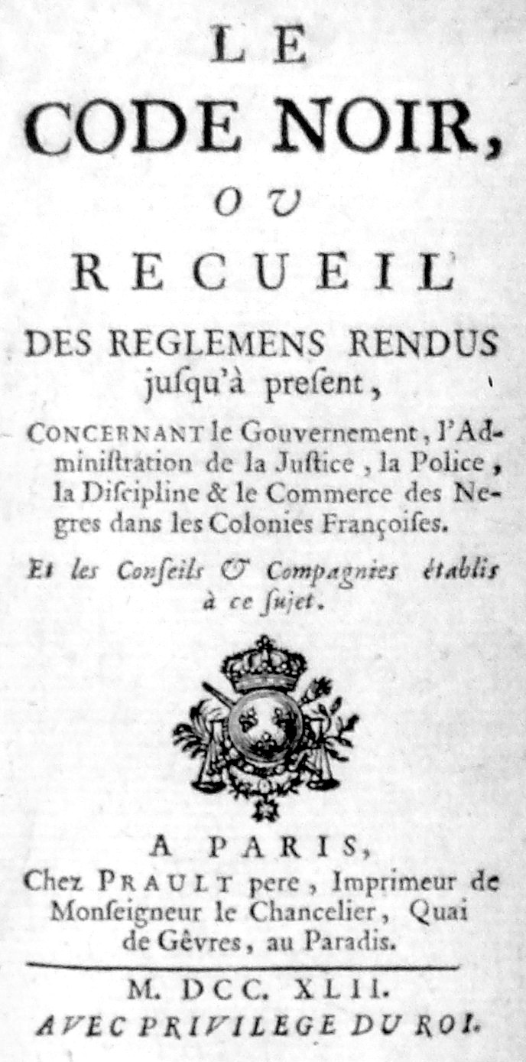
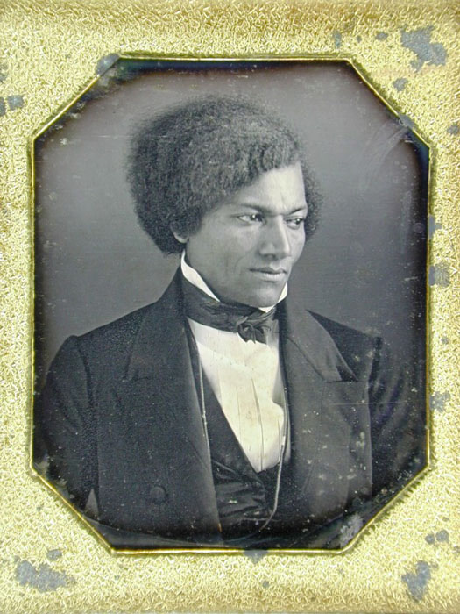
What is code?

Slide 4
Black Code
1662 – Virginia officially recognizes slavery as heredity
“Whereas some doubts have arisen whether children got by any Englishman upon a Negro woman should be slave or free, be it therefore enacted and declared by this present Grand Assembly, that all children born in this country shall be held bond or free only according to the condition of the mother; and that if any Christian shall commit fornication with a Negro man or woman, he or she so offending shall pay double the fines imposed by the former act.”
1685 – France promulgates the Code Noir, the first comprehensive slave code for the Americas to be issue by an imperial power
Articles: On family formation, on rations, no leaving plantations without passes, no running away, no sex across the color line, restrictions on manumission (i.e. getting free from slavery), no selling goods on your own….

Slide 5
Maryland
1664 - Be it enacted by the Right Honorable the Lord Proprietary by the advise and consent of the upper and lower house of this present Generall Assembly, that all Negroes or other slaves already within the province, and all Negroes and other slaves to be hereafter imported into the province, shall serve durante vita [hard labor for life]. And all children born of any Negro or other slave shall be slaves as their fathers were, for the term of their lives. And forasmuch as divers freeborn English women, forgetful of their free condition and to the disgrace of our nation, marry Negro slaves, by which also divers suits may arise touching the issue of such women, and a great damage befalls the masters of such Negroes for prevention whereof, for deterring such freeborn women from such shameful matches. Be it further enacted by the authority, advise, and consent aforesaid. that whatsoever freeborn woman shall marry any slave from and after the last day of this present Assembly shall serve the master of such slave during the life of her husband. And that all the issue of such freeborn women so married shall be slaves as their fathers were. And be it further enacted, that all the issues of English or other freeborn women that have already married Negroes shall serve the masters of their parents till they be thirty years of age and no longer.

Slide 6
Jean, of St. Domingo
Criminal audience and condemnation of him; between the Attorney General the Attorney and Plaintiff and Accuser and Negro, belonging to Sr. Mandeville, accused Jean, Native of St. Domingo, guilty of running away for amend of which has condemned and condemns him to be whipped with a switch on all cross roads of the city by the hangman, conducted on the square tied to a post to be hamstrung branded with a hot iron in shape of a v on the right cheek, afterwards returned to his master.
1764, New Orleans

Slide 7
Making Humans into Slaves
Louis Sala-Moulins
The 1685 Code Noir is "the worst refinement in wickedness, the most glacial technicality in the commerce of human flesh and in genocide" remains so difficult to find that it has vanished from historiography.”
Joan Dayan
Existing only as precepts and never in practice, the Black Code can be read as a philosophy of denaturalization, or put another way, the natural successor to Descartes's Discourse on Method and Meditations Concerning First Philosophy. The thinker of Descartes's Meditations in 1640 sets the stage for the 1685 edict of Louis XIV: the making of enlightenment man led to the demolition of the unenlightened brute

Slide 8
Barbara Fields on “Ideology”
Ideology is best vocabulary of day-to-day existence, through which people make rough sense of the social reality that they live and create from day to day. Ideologies do not need to be plausible, let alone persuasive, to outsiders. They do their job when they help insiders make sense of the things they do and see—ritually, repe- titively—on a daily basis."

Slide 9
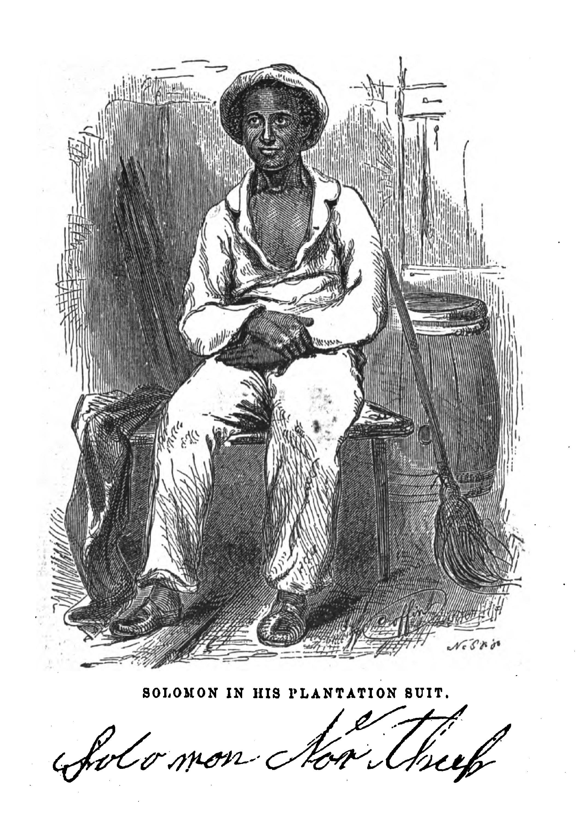
What is Blackness?
Solomon Northup was born a free man in Minerva, New York, in 1808. His father, Mintus, was originally enslaved to the Northup family from Rhode Island, but he was freed after the family moved to New York. As a young man, Northup helped his father with farming chores and worked as a raftsman on the waterways of upstate New York. He married Anne Hampton and they had three children together. During the 1830s, Northup became locally renowned as an excellent fiddle-player. In 1841, two men offered Northup generous wages to join a traveling musical show, but soon after he accepted, they drugged him and sold him into slavery. After years of bondage, he came into contact with an outspoken abolitionist from Canada, who sent letters to notify Northup's family of his whereabouts. An official state agent was sent to Louisiana to reclaim Northup. After he was freed, Northup filed kidnapping charges against the men who had defrauded him, but the lengthy trial that followed was ultimately dropped because of legal technicalities, and he received no remuneration. Little is known about Northup's life after the trial, but he is believed to have died in 1863.
Notes:
12 Years a Slave trailer
https://www.youtube.com/watch?v=-hfWywTRAjA&feature=youtu.be
12 Years a Slave Featurette
http://facesofsolomon.com/

